Slide 1
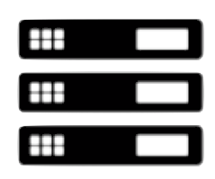





IGNITE Quality and Test Components
IGNITE Quality Platform
OPTIMIZE
Automate
ANALYZE
IGNITE TEST OPTIMIZATION
STAM
Document Analytics
IGNITE TEST AUTOMATION
Optimized Test Flow Automation
Performance
IGNITE
DEFECT ANALYTICS
Defect Analytics
Defect Predict
Defect Classify
Engage
Enterprise Data
Selenium
Appium
Perfecto
REST
SOAP UI
Commercial
Requirements
User Stories
Test Cases
Combinatorial Test Design
Test Data Management
Data Provisioning & Fabrication
Industry Assets
Test Models
Cognitive Engine
IGNITE Knowledge Management
Outcomes
Maximized Test Coverage
Optimized Test cases
Faster test execution
Reduced effort
Defect Prevention
Reduced defects
Benefits
100%
Test Coverage
25% to 70%
Test Case Reduction
30% to 40%
Effort Reduction
20% to 40%
Defect Reduction

